Slide 1

Relax, it's SPA time Mónica Rodrigues
60ª Reunião Presencial - 19/03/2016
http://netponto.org

Slide 2
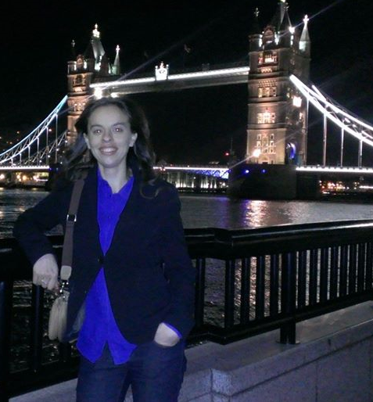

Who I am?
Mónica Rodrigues
Degree in Computer Science Engineer at ISEL
Web development since 2010
HTML5, CSS3, AngularJs, Knockout, Asp.Net WebApi, ASP.NET MVC, C#, SQL Server 2014
Member and Organizer

Slide 3
Contents
Challenge
Solution
Motivations
Considerations
Multiple page application vs SPA
Multiple page application and SPA - Mix
Some Javascript Frameworks
SPA Samples
What I need for begin
Recomendations
Javascript Patterns
Demo
References

Slide 4
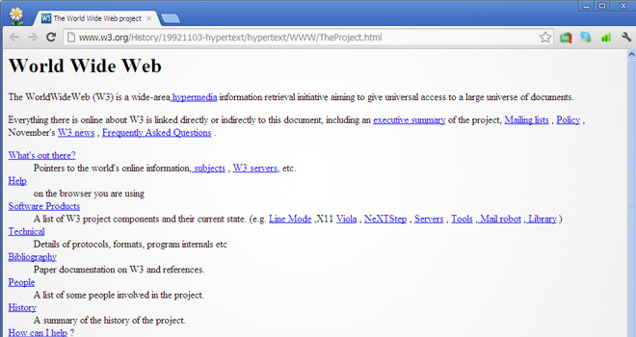
First page – Long time ago

Slide 5
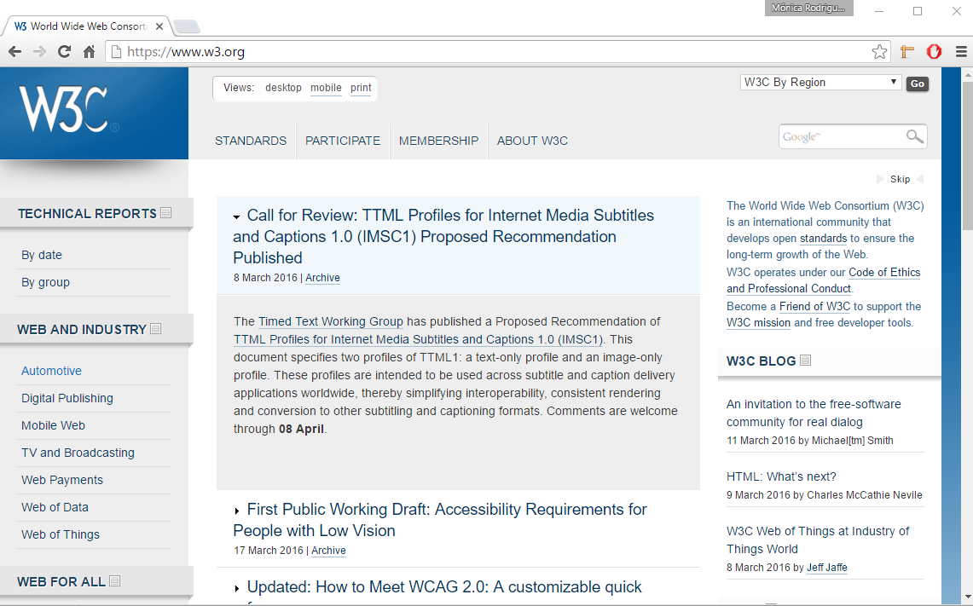
Today

Slide 6
Challenge
Users want a central place to view or take actions on most or all content so they don’t have to waste time navigating between pages.

Slide 7
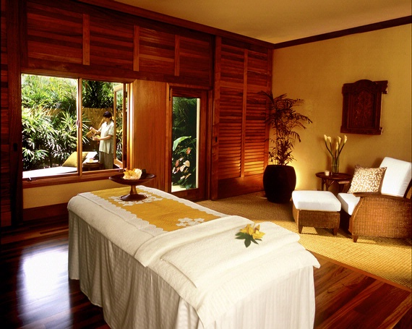
Solution
Go to a SPA

Slide 8
Solution
Use modern web development techniques to build a single-page app that doesn’t need to reload itself as the user browses through it.
SPA
Single Page Application

Slide 9
Motivations
3R’s
Reach
Web app may be accessible on different platforms and devices
Reponsive
Web app needs to be very responsive to different screen resolutions
Round trip
Web app does not require many round trips between client and server

Slide 10
Motivations (Continue)
Better user experience
Separation of responsibilities between client and server
Offline Applications

Slide 11
Considerations
The first time that the applications loads is slow
Maintain Navigation, Deep linking and History
SEO (Search engine optimization) is complicated

Slide 12
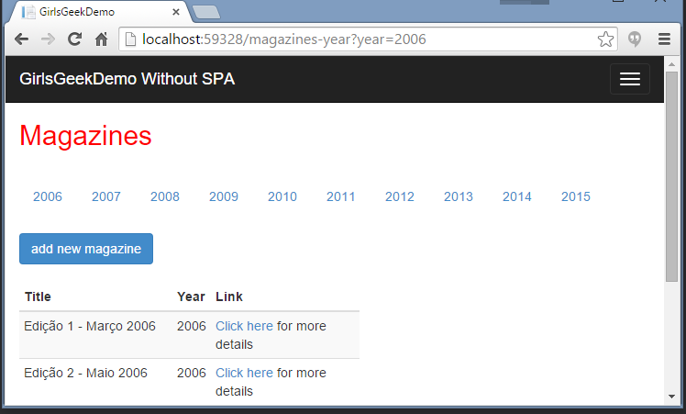

Multiple Page Application
Page access
Page rendering
Returns rendered page

Slide 13
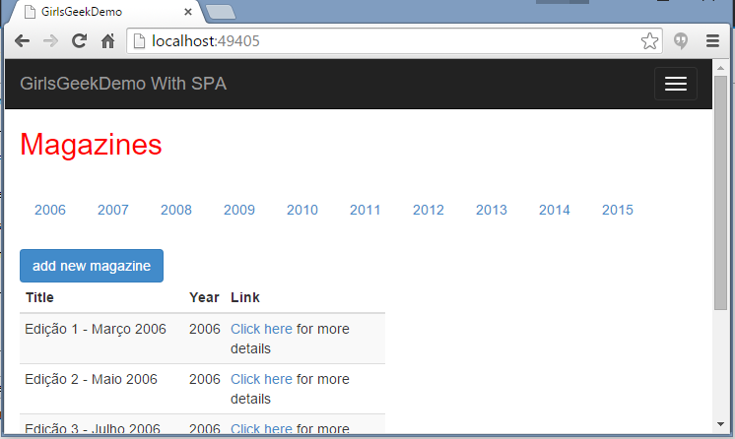
Single Page Application
Requests data
DOM processing and manipulation
Returns data

Slide 14
SPA and Multiple Page Application (Mix)
Products Page
Mini SPA
Request data
Returns data
Categories Page
Request data
Mini
SPA
Returns data

Slide 15






Some Javascript Frameworks and Libraries

Slide 16







SPA Samples

Slide 17
What I need for begin?
Choose a framework or library
Depends, what do you want to do?
Choose a IDE and structure your folders directory
Think about your application, namely HTML structure and CSS.
Lets start with Javascript ☺
Don’t forget the best practices!!

Slide 18
Recomendations
Best practices in Javascript
Join and minify CSS files and Javascript files
Use a task runner for help – Gulp
Learn MVVM pattern
App.js
deploy
site.min.js
App-users-controller.js

Slide 19
JavaScript Patterns
Functions as abstractions
Functions to build modules
Functions to avoid global variables

Slide 20
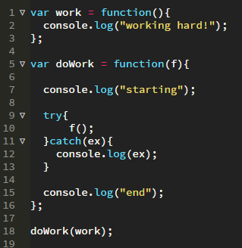
Functions as abstractions

Slide 21
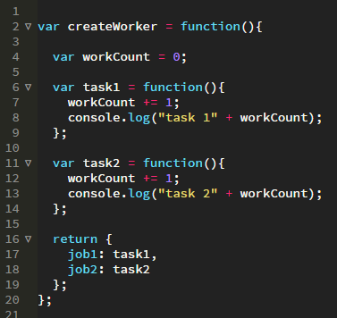

Functions to build modules
Revealing module pattern

Slide 22
Functions to build modules (Continue)
What’s the matter in code before?
There is two global variables
worker
createWorker
These variables can be redefined in other files

Slide 23
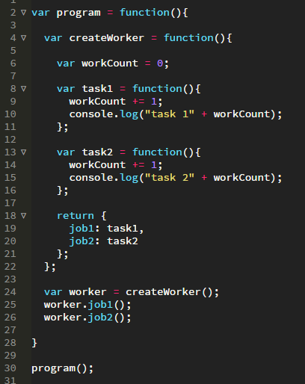
Functions to avoid global variables
Reduce for 1 global variable
But, how can I get 0 global variables?

Slide 24
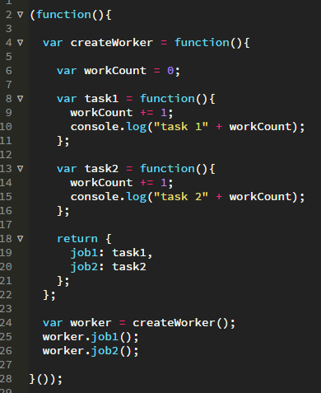
Functions to avoid global variables – (Continue)

Slide 25
NetPonto Attendance Manager SPA
demo

Slide 26

Questions?

Slide 27
References
Angular Js
https://angularjs.org/
Knockout
http://knockoutjs.com/
Aurelia
http://aurelia.io/
React
https://facebook.github.io/react/
Backbone
http://backbonejs.org/
Ember
http://emberjs.com/
John Papa
http://www.johnpapa.net/

Slide 28


Patrocinadores “GOLD”
Twitter: @PTMicrosoft
http://www.microsoft.com/portugal

Slide 29



Patrocinadores “Silver”
Notes:
Telerik
Ndepend
Pluralsight
syncfusion

Slide 30

Patrocinadores “Bronze”

Slide 31

http://bit.ly/netponto-aval-60
* Para quem não puder preencher durante a reunião,
iremos enviar um email com o link à tarde
Notes:
Para quem puder ir preenchendo, assim não chateio mais logo ☺
É importante para recebermos nós feedback, e para darmos feedback aos nossos oradores
http://goqr.me/

Slide 32
Próximas reuniões presenciais
19/03/2016 – Lisboa
02/04/2016 – Porto
16/04/2016 – Lisboa
19/05/2016 – 21/05/2016 – TugaIT (Lisboa)
Reserva estes dias na agenda! :)

Slide 33



Thank you!
Mónica Rodrigues
Email: monica85rodrigues@gmail.com
Personal Website: http://fullhand.pt/
@Monica85Rodrig
https://pt.linkedin.com/in/monicascrodrigues
https://github.com/monica85rodrigues
https://github.com/monica85rodrigues/presentation-netponto-spa

